Slide 1
Preliminary Data Findings
December 8, 2020

Slide 2
Bugs
First test notes:
Piece bent more than expect and went outside range of press
Caused force gauge to hit bed of press and d shaft fell off so we had to put it back on
Fix: lift the press bed up a little with some bolts
Strain gauge was better than expected, however it goes outside the range of our HX711 sensor quickly
Fix: turn down the gain on the HX711
Strain gauge still going outside range
Fix: adjust the wheatstone bridge to push 0 towards the lower bound so the range is larger since we only measure strain in one direction.

Slide 3
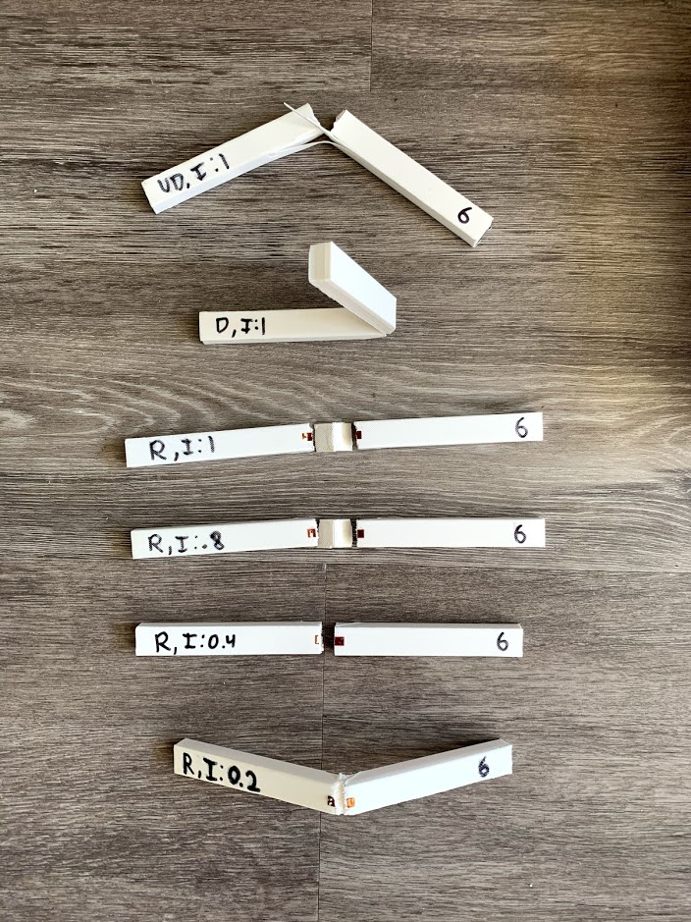
First Batch

Slide 4

First test
https://photos.app.goo.gl/wfQbxXU5TaihxfBj8

Slide 5
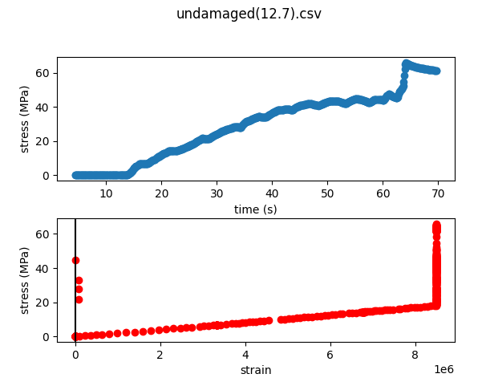
First Undamaged Test
Used incorrect span (should be 16cm)
100% Infill
Hit the press itself at the end (that’s the spike)
Strain here is uncalibrated
Strain hit max sensor read
Straight line though which is good!

Slide 6
Undamaged (100% infill)
https://photos.app.goo.gl/yRg5J56zs8XPNKnQ7

Slide 7
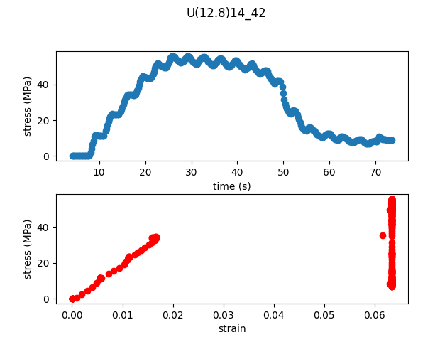
Undamaged (100% infill)
Strain gauge broke at ~38MPa

Slide 8
Damaged (100% infill)
https://photos.app.goo.gl/wGTUnfZ9RmsxzWtP6

Slide 9
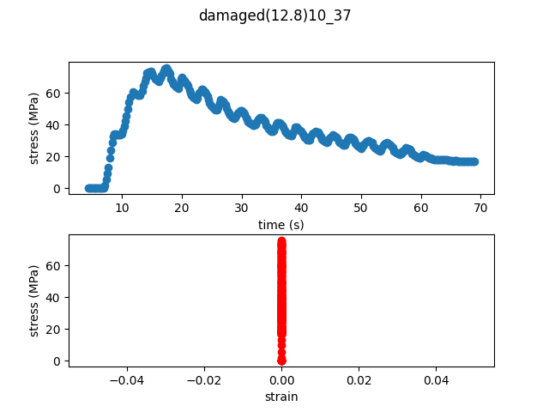
Damaged Data
Reaches ultimate stress of 75MPa which is similar to the ultimate strength of the repaired part
Max Load: 4.35kg
Note: No strain data

Slide 10
First Repaired Test (100% infill)
https://photos.app.goo.gl/XzfoYSyNWFMJgpy96

Slide 11
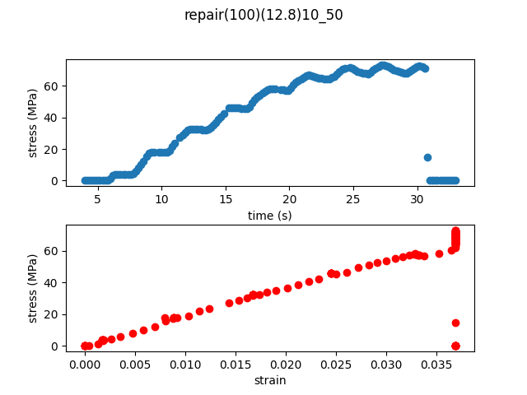
Repaired (100% infill) Data
Strain still hits max value but it’s only for the last part (working on fix for this)
Reaches a ultimate stress of 73 MPa
Max Load: 46.6kg

Slide 12
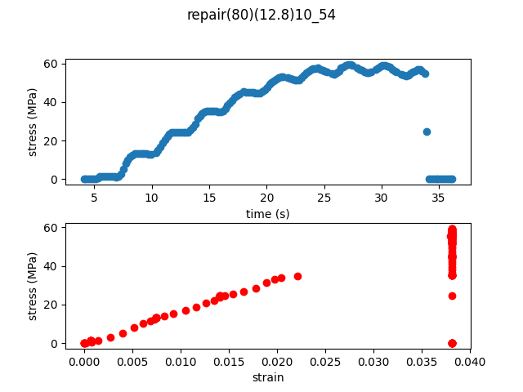
Repair (80% infill)
Reaches ultimate stress of 59.4MPa

Slide 13
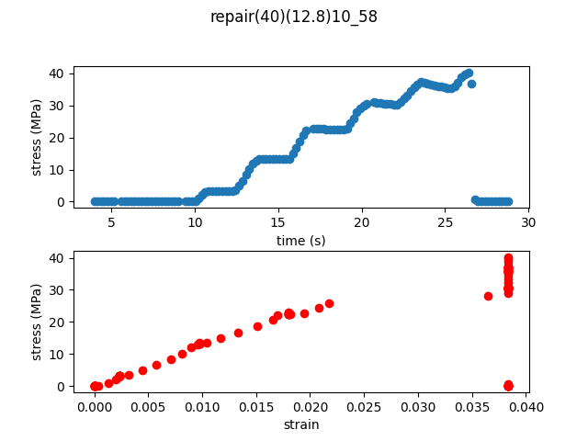
Repair (40% infill)
Reaches ultimate stress of 40MPa

Slide 14
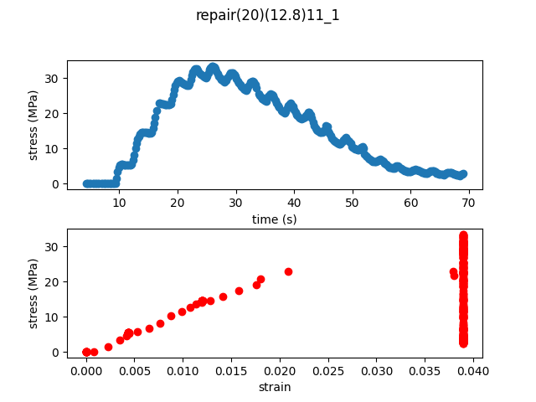
Repair (20% infill)
Reaches a ultimate strength of 33.4MPa

Slide 15
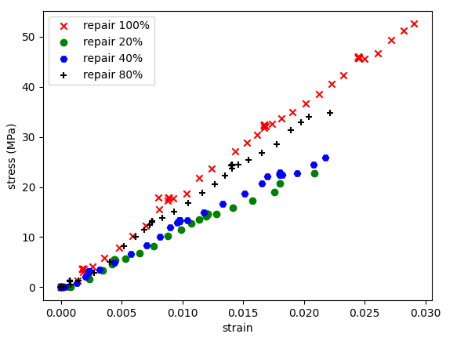
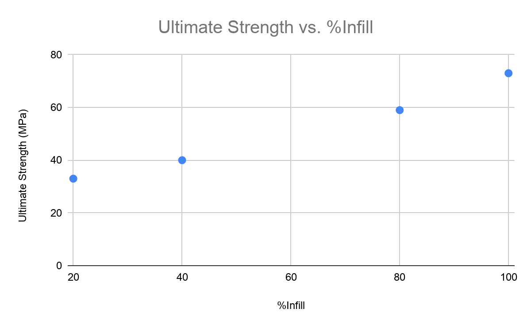
Repairison
Different Young’s modulus is expected since we don’t account for the change in cross sectional area due to lowered infill here.

